Slide 1
Research and Development in Biomedical Engineering Research in the Philippines
Engr. Voltaire B. Dupo, ECE
Compiled for IECEP

Slide 2
Disclaimer
The discussion that you will hear would be both based on what I have experienced from DLSU-IBEHT and the implementation of DOST-PCHRD funded projects at DLSU and published works relevant to the discussion and does not reflect the complete/full position of DLSU and PCHRD.
DLSU-IBEHT’s projects and events are supported by DOST-PCHRD.

Slide 3
NY City College BME Fundamental Subjects
120 credits Common Required Subjects | Programming for Engineers | Calculus 1 | General Chemistry 1 | Foundations of Biology | English 1 | Liberal Arts - Creative Expression
 | Biostatistics | Calculus 2 | General Chemistry 2 | Physics 1 |  | Liberal Arts - World Culture & Global Issues
 | Research Methods | Calculus 3 | Applied Chemistry | Physics 2 | Writing for Engineers | Liberal Arts - Individual and Society
 | Elements of Linear Algebra | Differential Equations | BioChemistry 1 |  |  | Liberal Arts - US Experience
 |  | Engineering Mechanics I | Chemical Engineering Thermodynamics 1 | Physiological Processes | Bioelectrical Circuits | Impact of Biomedical Technology
 |  | Mechanics of Materials | Transport Phenomenon 1 | Cell and Molecular Biology | Biomedical Transducers and Instrumentation
 | Experimental Methods in BME | Image and Signal Processing in Biomedicine |  | Cell and Tissue Mechanics | Cell and Tissue Biomaterial Interactions
 |  |  |  | Cell and Tissue Transport

Slide 4
NY City College BME Engineering Electives
at least 3 credit Engineering Elective | Engr Analysis | Poroelasticity | Engr Design (1cr) | Cell & Tissue Engr | Indep. Study (3cr) | Electromagnetics | Intro to Computing
 | Engr Mechs II | Contin Mechanics | Computer Aided Analysis Tools for Engineers (2cr) | Microflu. Dvcs. Biotech | BME Indep. Study (1cr) | Biomed Imaging | Biomed Signal Proc.
 | Cmptr Meths in Engr. | Cmptr-Aided Design | CAD (2cr) | Org Transp. Pharm’kin | Biofluid Mechs |  | Neur Engr & App Bioel
 | Spec. Tops n Mech. Lrn. | ChE Thermo II

Slide 5
NY City College BME Technical Electives
6-8 credit units required Technical Elective | Founds of Bio II | Prac. Med. Dev. Design | Lab in Cell & Mol Engr | Discrt Math Struct | Quant Analysis | Mod. Phys. Engrs | Clinical Immersion & Need Statement Development
 | Intro to Genetics | Adv Top in Med Ultrasd | Microflu Dev in Biotech | Numerical Anal | Org Chem I | Med. Phys.
 | ntro to Neurobio | Translational Nanomed | Bone Biol. & Biomech | Prob. Theory | Org Chem Lab I | Quant Mech
 | Microbiology | Cell Mechanotransduct | Skeletal Soft Tissue | Math. Stats. | Org Chemistry II | Biomed. Phys
 | Develop Bio | Cell Mechanotransduct |  | Appl Stats & Prob | Environ Org Chem | Bioinformat
 | Cell Dev-Senes | Intel Prop, Reg & Qual |  | Cmplx Var Sci & E | Biochem I |  | Scientific Ethics
 | Virology | Trans Chllges n Diag Dev |  |  | Physical Chem I
 | Cancer Biology |  |  |  | Physical Chem II
 | Sensory Percept |  |  |  | Nanomats
 | Lab in Biotech |  |  |  | Pharm Appl
Design | BME Senior Design I
 | BME Senior Design II

Slide 6
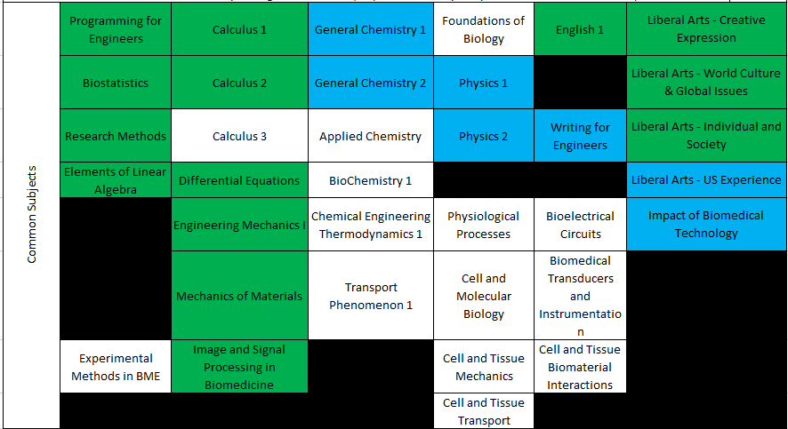
ECE Covered Fundamental Subjects / with Equivalents

Slide 7
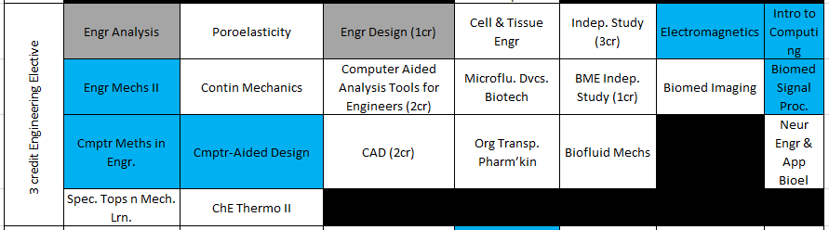
ECE Covered Engineering Electives/ with Equivalents

Slide 8
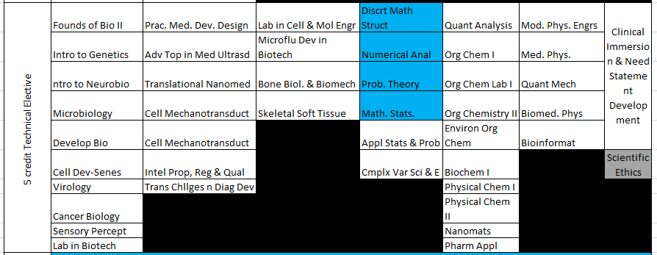
ECE Covered Technical Electives/ with Equivalents

Slide 9
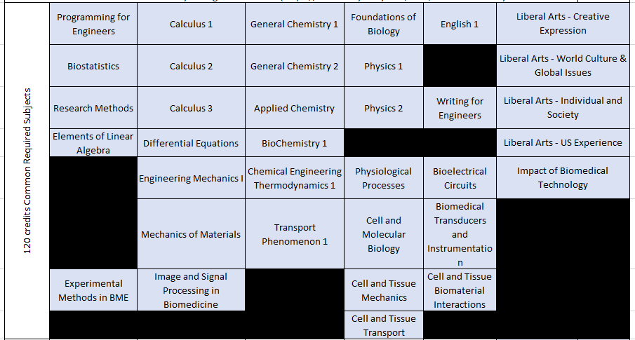
Fundamental Subjects to be taken for Any Specialized Direction of Practice

Slide 10
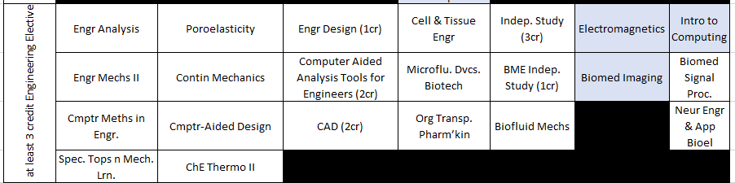
Subjects to be taken for Medical Imaging Direction of Practice

Slide 11
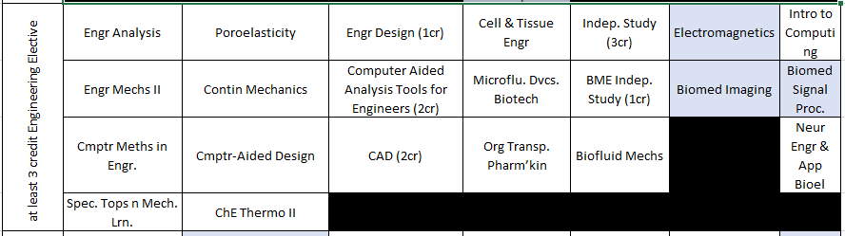
Subjects to be taken for Clinical Engineering Direction of Practice

Slide 12
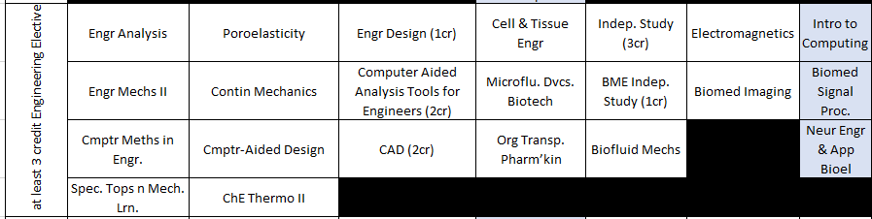
Subjects to be taken for Vital Signs Direction of Practice

Slide 13
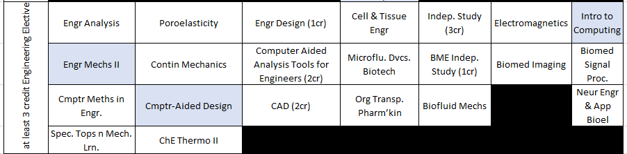
Subjects to be taken for Medical Robotics Direction of Practice

Slide 14
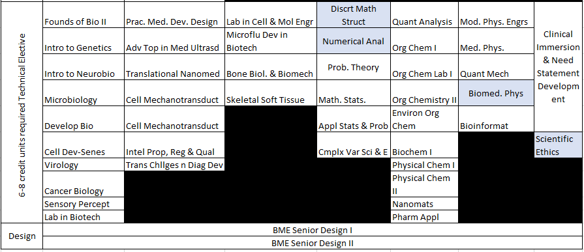
Subjects to be taken for Medical Imaging Direction of Practice

Slide 15
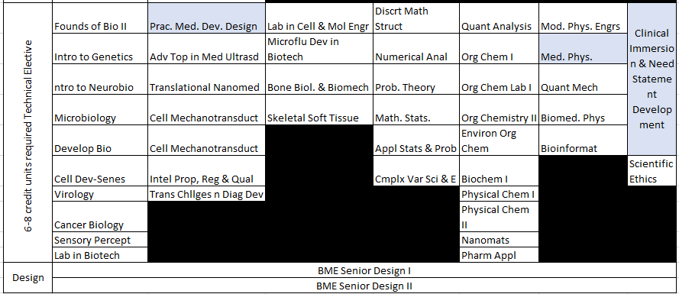
Subjects to be taken for Clinical Engineering Direction of Practice

Slide 16
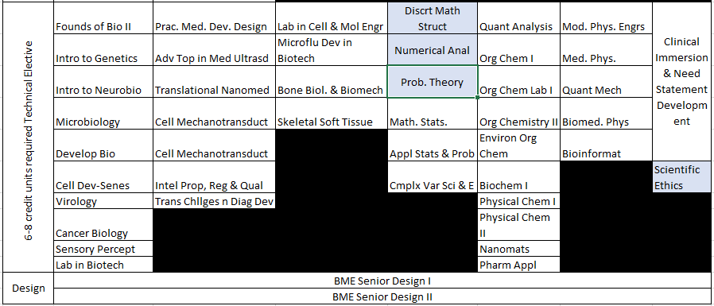
Subjects to be taken for Vital Signs Direction Direction of Practice

Slide 17
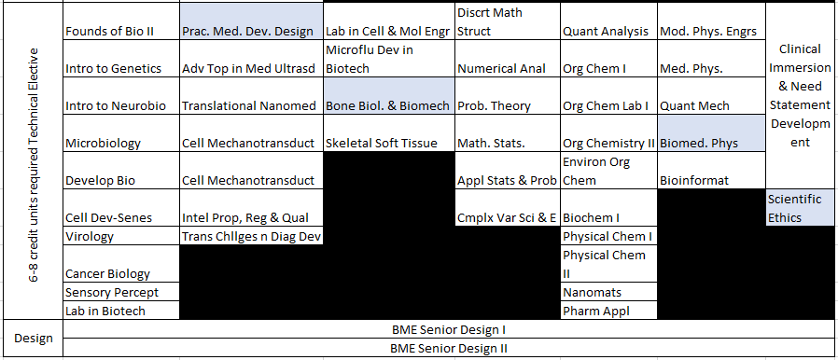
Subjects to be taken for Medical Robotics Direction Direction of Practice

